Slide 1
Pattern Recognition Using Machine Learning
Student: Zhiming Lin
Supervisor: Dr. Yue Liu
Assessor: Dr. Xu Yang

Slide 2
Outline
Introduction
Background
Results:
Setup datasets
YOLO models
Web application
Conclusion

Slide 3
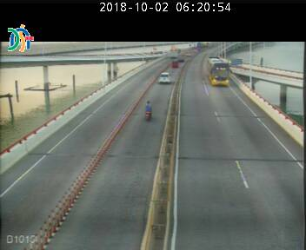
Introduction – problem & solution
Novelty:
Apply object detection algorithms on Macao traffic.
Optimize the algorithms to fit better in Macao case.
Web applicaiton provides real-time traffic images and analysis.
Traffic congestion is one of the major problems in Macao.
The DSAT website provides real-time traffic images but not any analysis on the traffic status.
Sample image from DSAT

Slide 4
1. Traffic Analysis Method Proposed by A. Atvar, Y. Artan and Ş. Öztürk
A specific region is selected manually from the traffic images to perform Leunger-Malik (LM) filter and Random Forest algorithm.
Limitations:
The congestion level is better detected by machine automatically without other user’s inputs.
The modern machine learning algorithms should be used to detect objects.

Slide 5
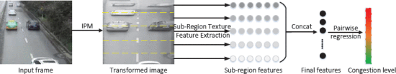
2. Traffic Congestion Analysis Proposed by J. Wan, Y. Yuan and Q. Wang
Proposed procedure
Limitations:
Weak label of the vehicles’ positions.
Not well-tuned networks are used(variation of AlexNet and CNN-LSTM).

Slide 6
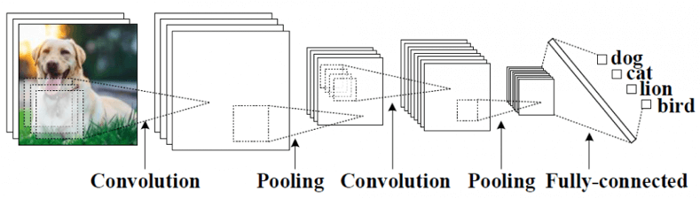
Convolutional Neural Network
Simple CNN example

Slide 7
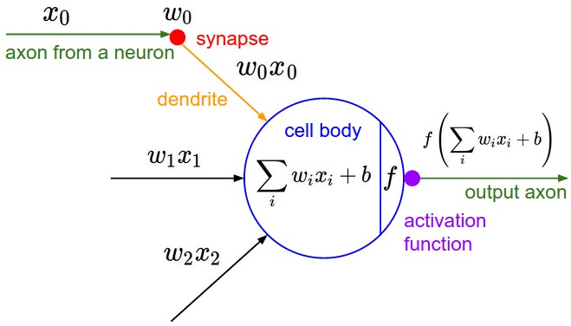
Convolutional Neural Network
Sigmoid
ReLU
Linear
etc.
Convolutional layer

Slide 8
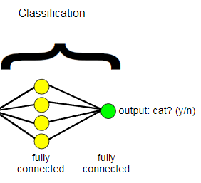
Convolutional Neural Network
Fully connection layer

Slide 9
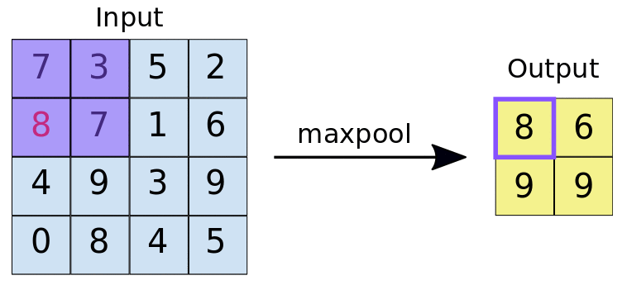
Convolutional Neural Network
Maxpooling layer

Slide 10

Convolutional Neural Network
Dropout layer

Slide 11
YOLOv1
The real-time object detection system was introduced in June 2015.
Detects 20 classes (VOC dataset) or 80 classes (COCO dataset).
Processes the images at 45 frames per second.

Slide 12
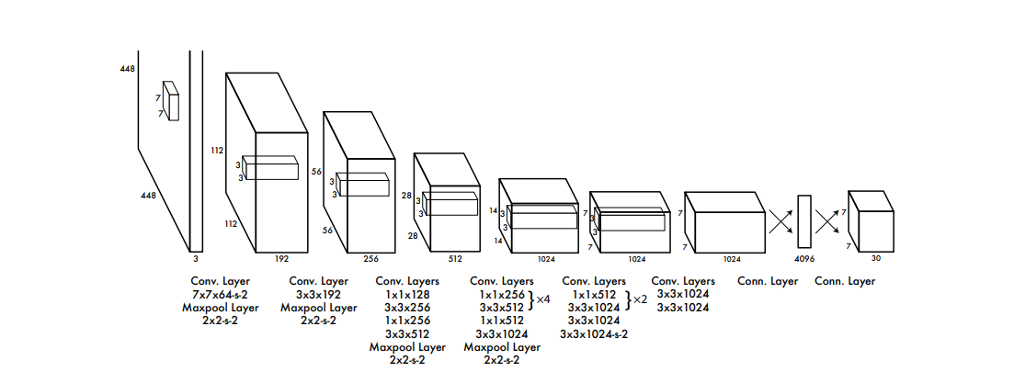
YOLOv1 - architecture
24 convolutional layers, 5 maxpooling layers, 2 fully connection layers and 1 dropout layers.

Slide 13
YOLOv1 - architecture
V1 divides the input image into S x S (7 x 7) grid cell.
Each cell predicts B (2) bounding boxes and the object confidence for each box.
6 predictions: coordinate (x, y), width & height, object confidence for each boxes and class(C = 20) probabilities for each cell. [ tensor: S x S x (B * 5 + C) ]

Slide 14
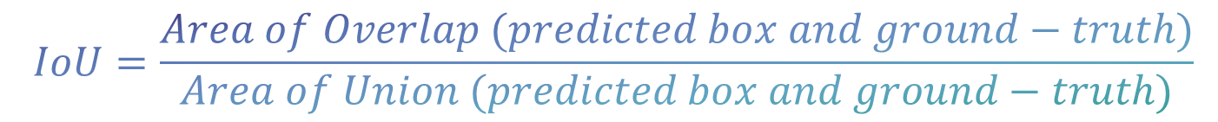


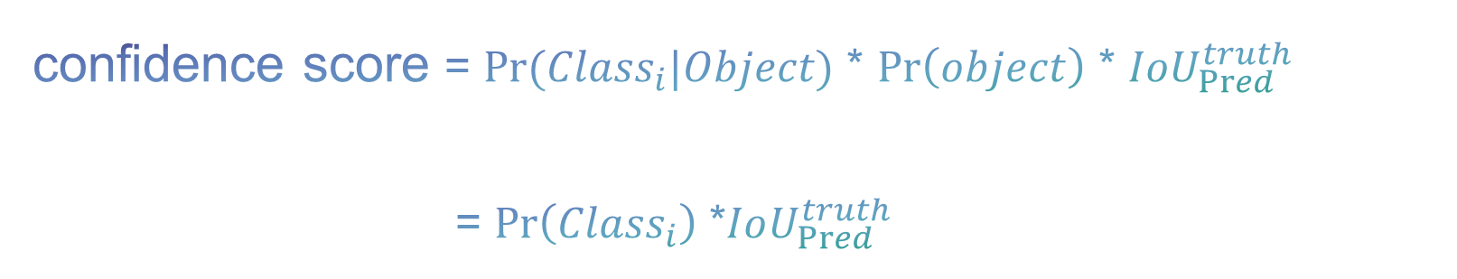
YOLOv1
$$IoU=\frac{Area of Overlap (predicted box and ground−truth)}{Area of Union (predicted box and ground−truth)}$$
confidence score = $Pr⁡({Class}_{i}|Object)$ * $Pr\left(object\right)$ * $IoU_{Pred}^{truth}$
= $Pr\left({Class}_{i}\right)$ *$IoU_{Pred}^{truth}$
activation function for the final layer:$∅\left(x\right)=x$
activation function for the rest of layers:$∅\left(x\right)= \left\{\begin{aligned}x, if x>0 \\ 0.1x, otherwise\end{aligned}\right.$

Slide 15
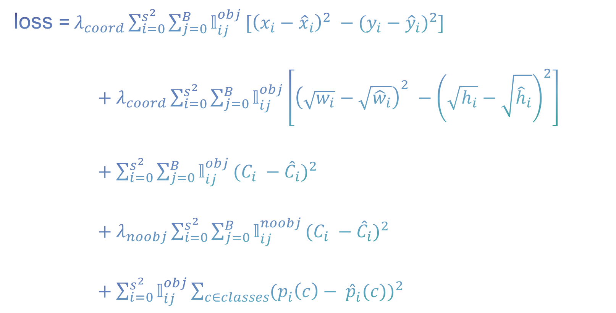
YOLOv1
loss = $λ_{coord}\sum_{i=0}^{s^{2}}{\sum_{j=0}^{B}{𝕝_{ij}^{obj}}}[{\left(x_{i}−{\hat{x}}_{i}\right)}^{2} −{(y_{i}−{\hat{y}}_{i})}^{2}]$
+ $λ_{coord}\sum_{i=0}^{s^{2}}{\sum_{j=0}^{B}{𝕝_{ij}^{obj}}}\left[{\left(\sqrt{w_{i}}−\sqrt{{\hat{w}}_{i}}\right)}^{2} −{\left(\sqrt{h_{i}}−\sqrt{{\hat{h}}_{i}}\right)}^{2}\right]$
+ $\sum_{i=0}^{s^{2}}{\sum_{j=0}^{B}{𝕝_{ij}^{obj}}}{(C_{i} −{\hat{C}}_{i})}^{2}$
+ $λ_{noobj}\sum_{i=0}^{s^{2}}{\sum_{j=0}^{B}{𝕝_{ij}^{noobj}}}{(C_{i} −{\hat{C}}_{i})}^{2}$
+ $\sum_{i=0}^{s^{2}}{𝕝_{ij}^{obj}}\sum_{c∈classes}{{(p_{i}^{}\left(c\right)− {\hat{p}}_{i}^{}(c))}^{2}}$

Slide 16
YOLOv2 - the most important updated feature
Introduces 5 fixed size bounding boxes called anchor boxes. It predicts the offsets rather than predicting bounding boxes directly which reduces the complexity.
YOLOv3 - the most important updated feature
Predict objects in 3 scales. 3 anchor boxes for each scale.

Slide 17
YOLOv2 - updated features
Introduces 5 fixed size bounding boxes called anchor boxes. It predicts the offsets rather than predicting bounding boxes directly which reduces the complexity.
Adds batch normalization for all convolutional layers and removes dropout layer.
Adds a passthrough layer to bring higher resolution features.

Slide 18
YOLOv3 - updated features
Linear function is changed to Logistic function for predicting object confidence.
The loss for class prediction is calculated by binary cross-entropy.
Predict objects in 3 scales. 3 anchor boxes for each scale.

Slide 19
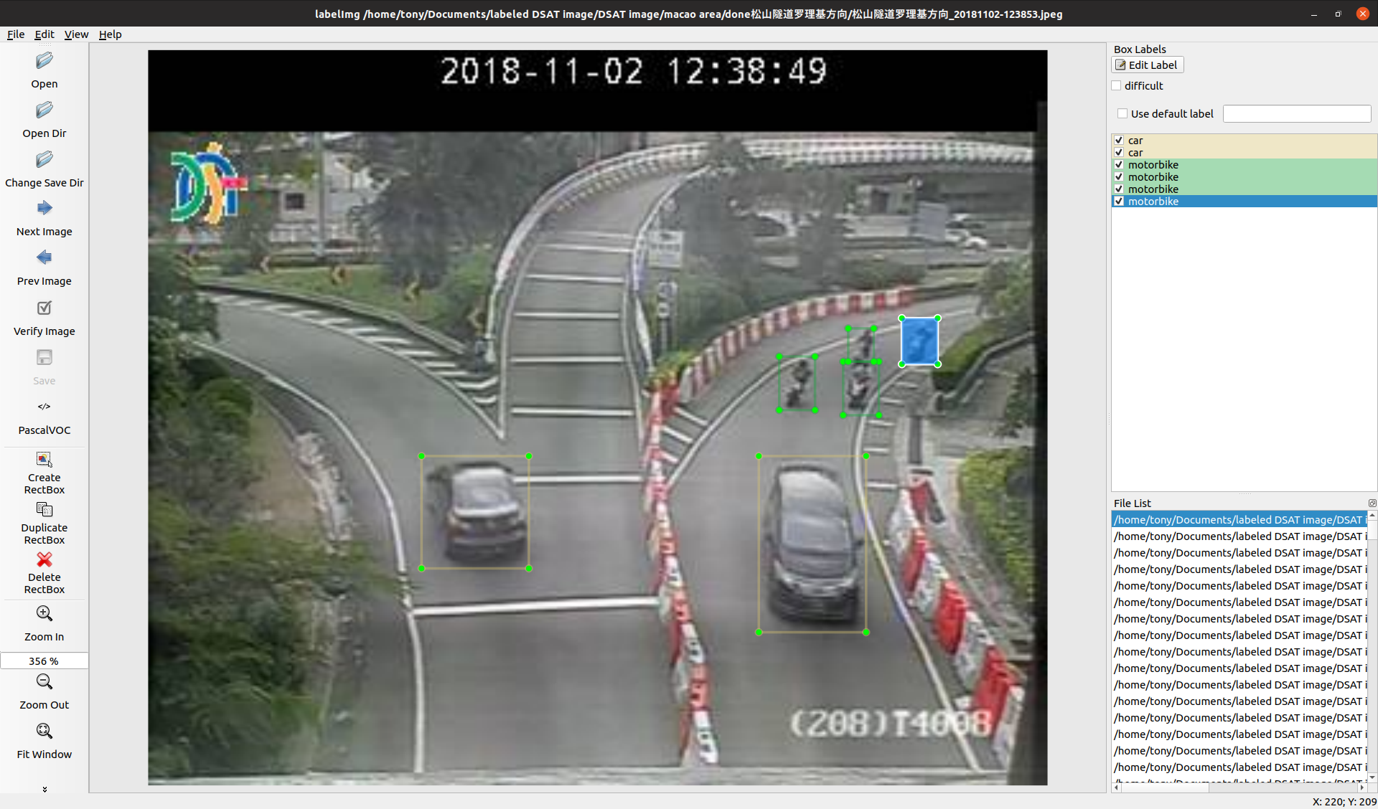
Datasets
Total: 3901
Training dataset: 3511
Test dataset: 351
Validation dataset: 39
4 classes
Bus
Car
Motorbike
Truck

Slide 20
YOLO models
No. of detection classes
No. of convolutional layers
Tiny YOLOv2
20
9
YOLOv2
20/80
19
YOLOv3
80
53

Slide 21
YOLO models
Retrain three YOLO models on self-made DSAT datasets.
The predicted classes are restricted to 4 traffic-related classes.
 | Tiny YOLOv2 model | YOLOv2 model | YOLOv3 model
No. of epochs | 100 | 100 | 100
Learning rate | 1e-5 | 1e-5 | 1e-3
Batch size | 64 | 32 | 48
Score threshold | 0.1 | 0.1 | 0.3
IoU threshold | 0.5 | 0.5 | 0.45
Full retraining? | Yes | Yes | No (only last 3 layers)

Slide 22
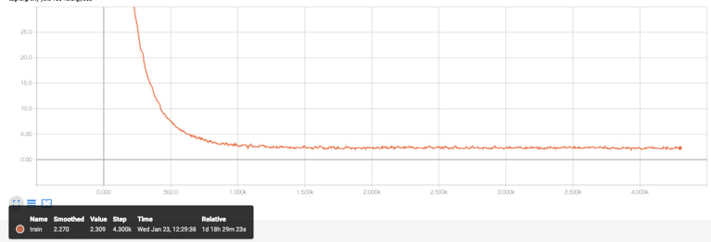
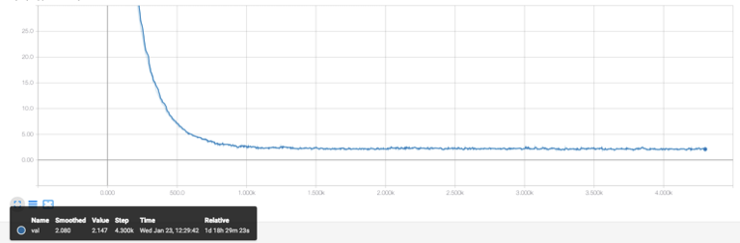
Tiny YOLOv2
Training loss – 2.309 (lowest value)
Validation loss – 2.147 (lowest value)

Slide 23
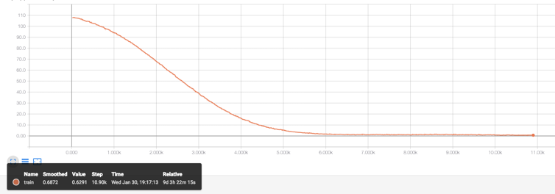
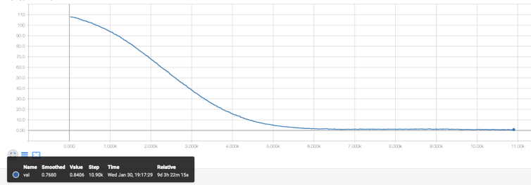
YOLOv2
Training loss – 0.6872 (lowest value)
Validation loss – 0.7680 (lowest value)

Slide 24
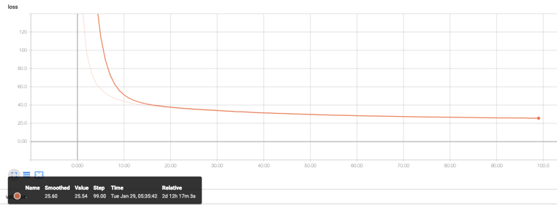
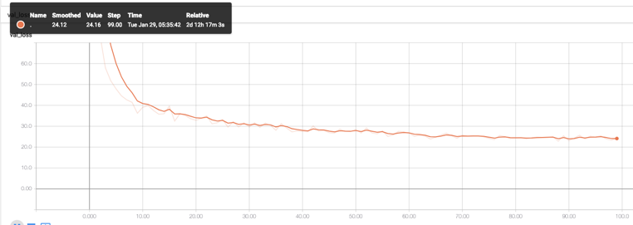
YOLOv3
Training loss – 25.54 (lowest value)
Validation loss – 24.12 (lowest value)

Slide 25
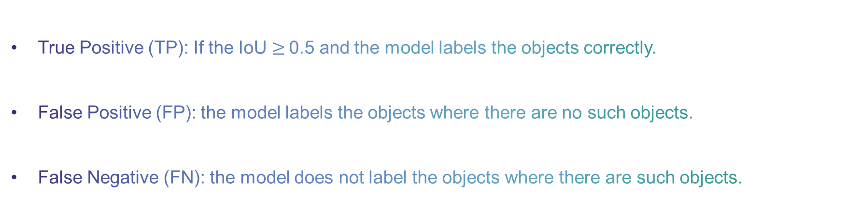
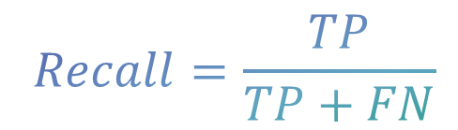
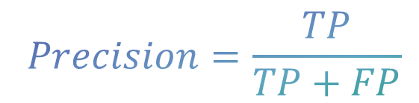
Average precision (AP)
$$Precision=\frac{TP}{TP+FP}$$
$$Recall=\frac{TP}{TP+FN}$$
AP: the area under the precision-recall graph.
True Positive (TP): If the IoU $≥$0.5 and the model labels the objects correctly.
False Positive (FP): the model labels the objects where there are no such objects.
False Negative (FN): the model does not label the objects where there are such objects.

Slide 26
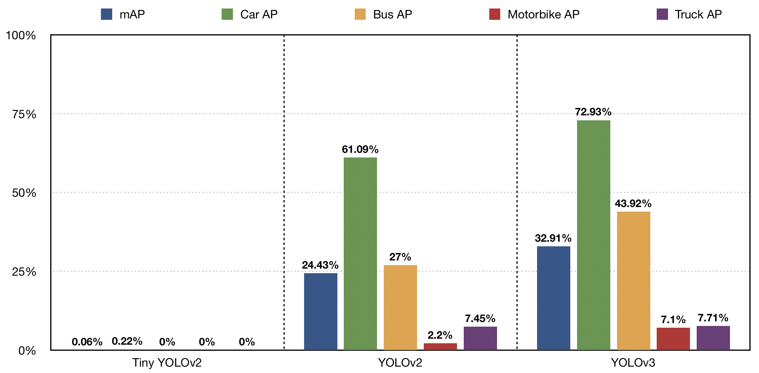
YOLO models – before retraining

Slide 27
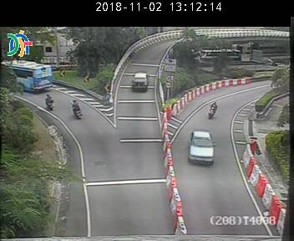
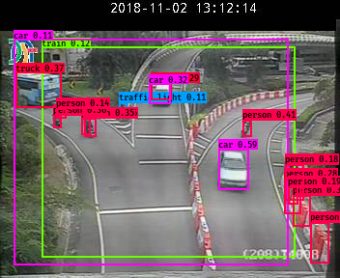
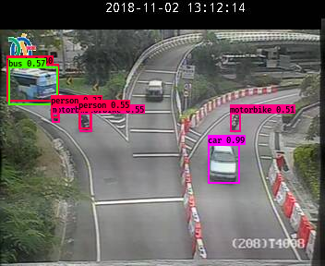
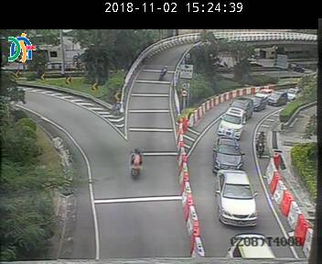
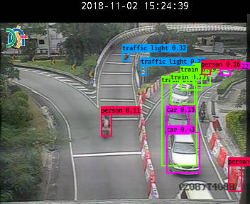
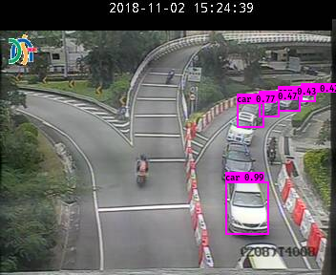
Light:
Tiny YOLOv2
YOLOv2
YOLOv3
Heavy:
Tiny YOLOv2
YOLOv2
YOLOv3

Slide 28
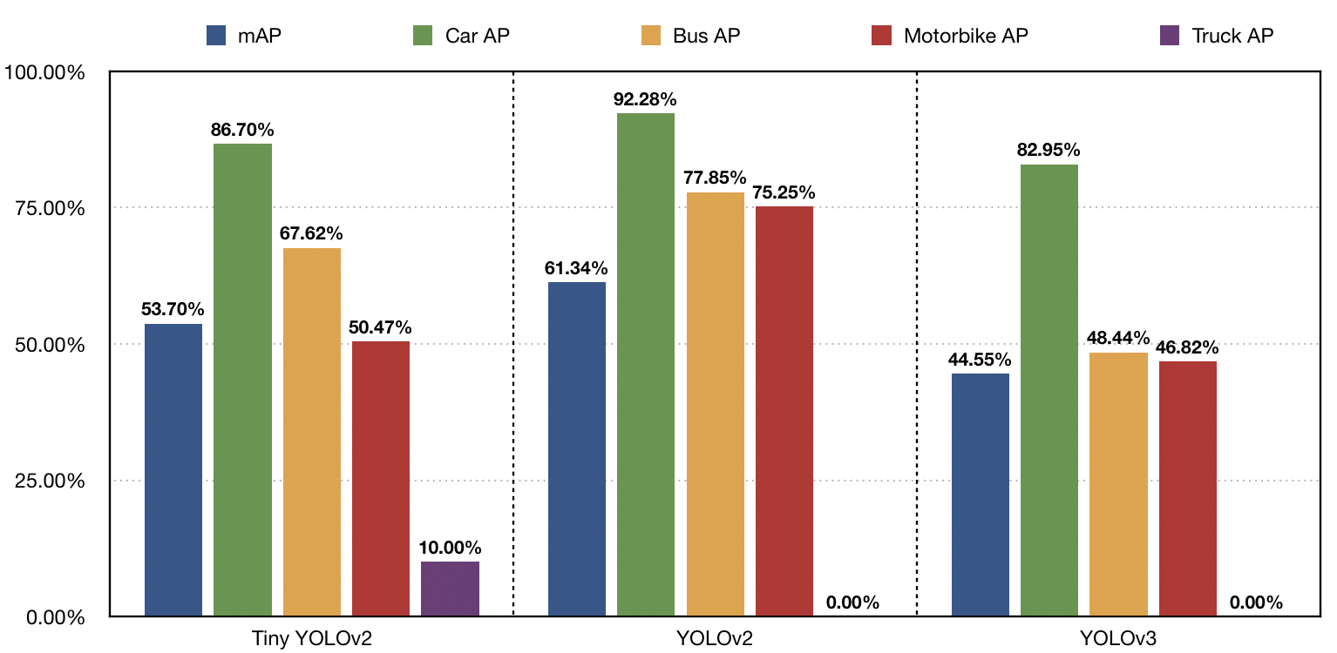
YOLO models – after retraining

Slide 29
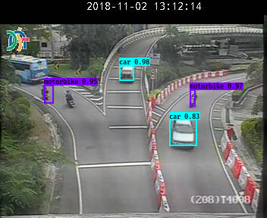
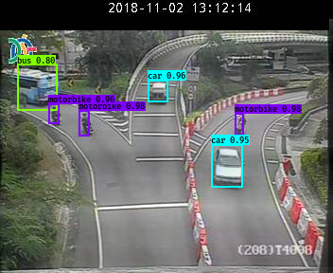
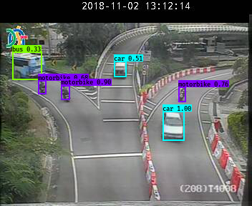
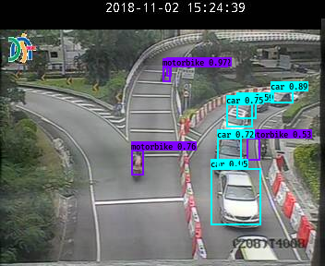

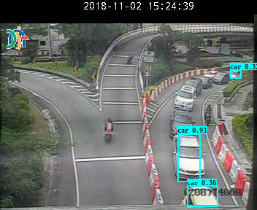
Light:
Tiny YOLOv2
YOLOv2
YOLOv3
Heavy:
Tiny YOLOv2
YOLOv2
YOLOv3

Slide 30
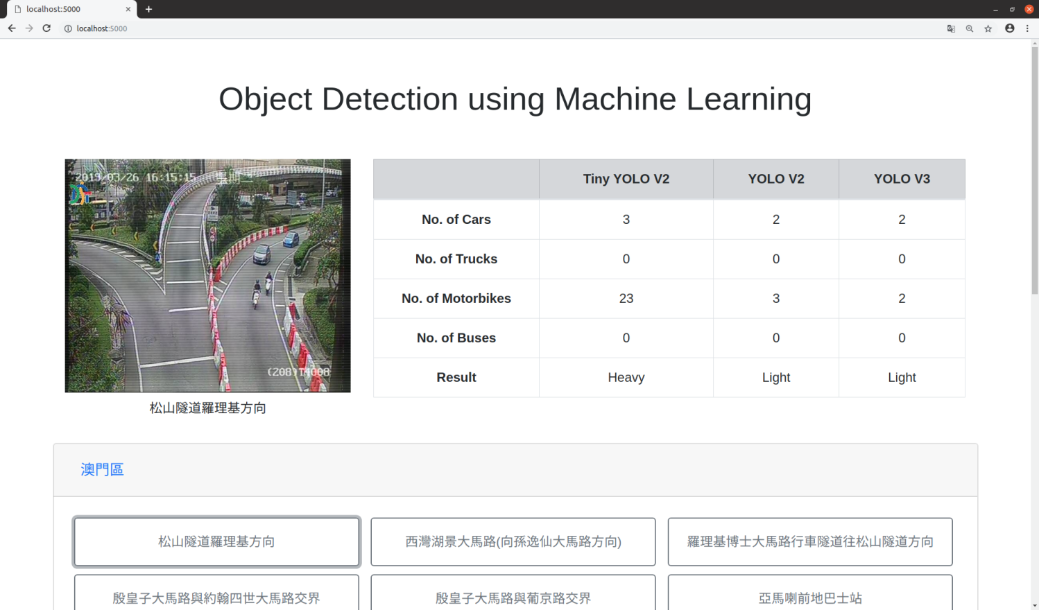
Web application
Real-time traffic images from more than 40 places.
Detection results from models and images are updated every 5 seconds.
Traffic congestion level:
light: <12
Moderate: 12 ~ 24
Heavy: >24

Slide 31
Conclusion
The datasets consist of 3901 DSAT traffic images with annotations are built from scratch.
After retraining, the improvements are significant. the tiny YOLOv2 model increases its mAP more than 50% after retraining. YOLOv2 can achieve 61.45% mAP.
In addition, the web application is developed for commuters to have clearer ideas about the current traffic congestion level.

Slide 32
Thank you!

